Slide 1
Kaggle: Rent Hop Rental Listings predictions
TEAM:
POWER CROME AMAZING

Slide 2

INTRODUCTION
Developed models to predict rental listings: high, medium and low
Variable EDAs inclue: Location, Features, Latitude/Longitude and Price
Developed models: KNN, logistic, tree, xgBoost, SVM
Ensemble and score for final output
Next steps & future iterations

Slide 3
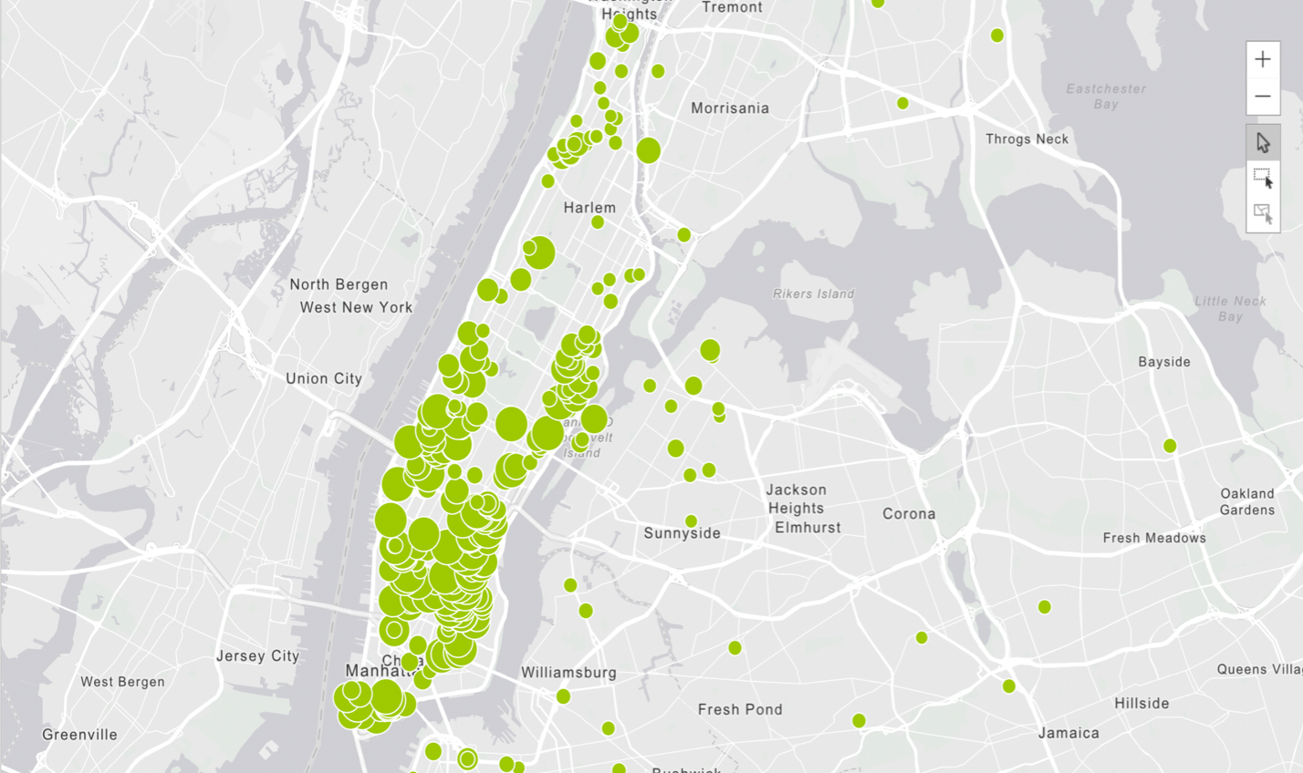
EDA: LOCATIONS OF PROPERTIES - HIGH

Slide 4
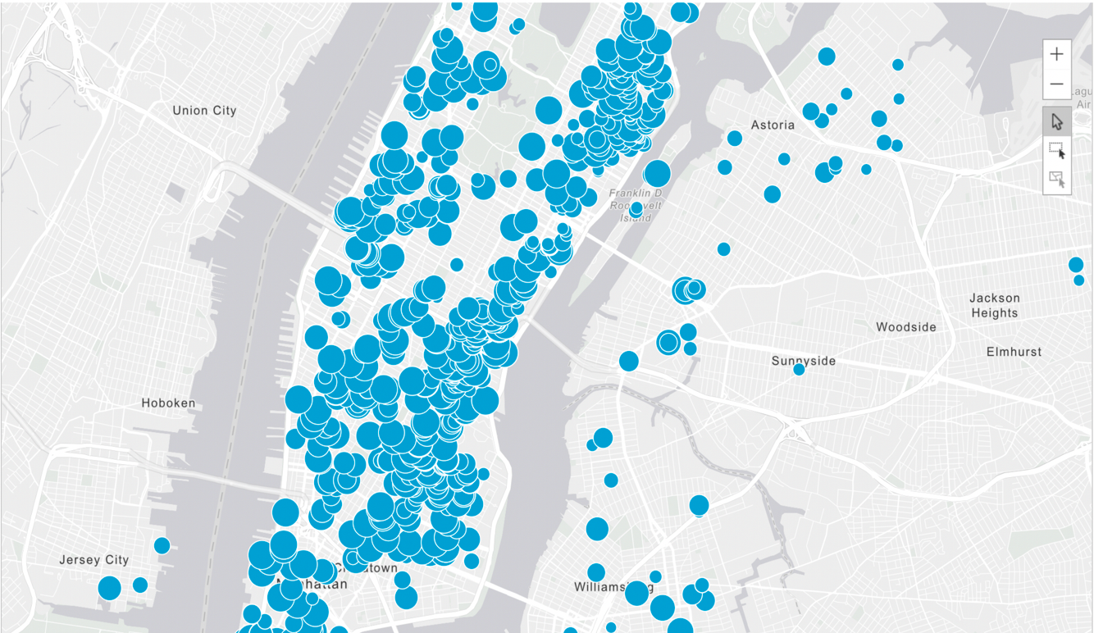
EDA: LOCATIONS OF PROPERTIES - MEDIUM

Slide 5
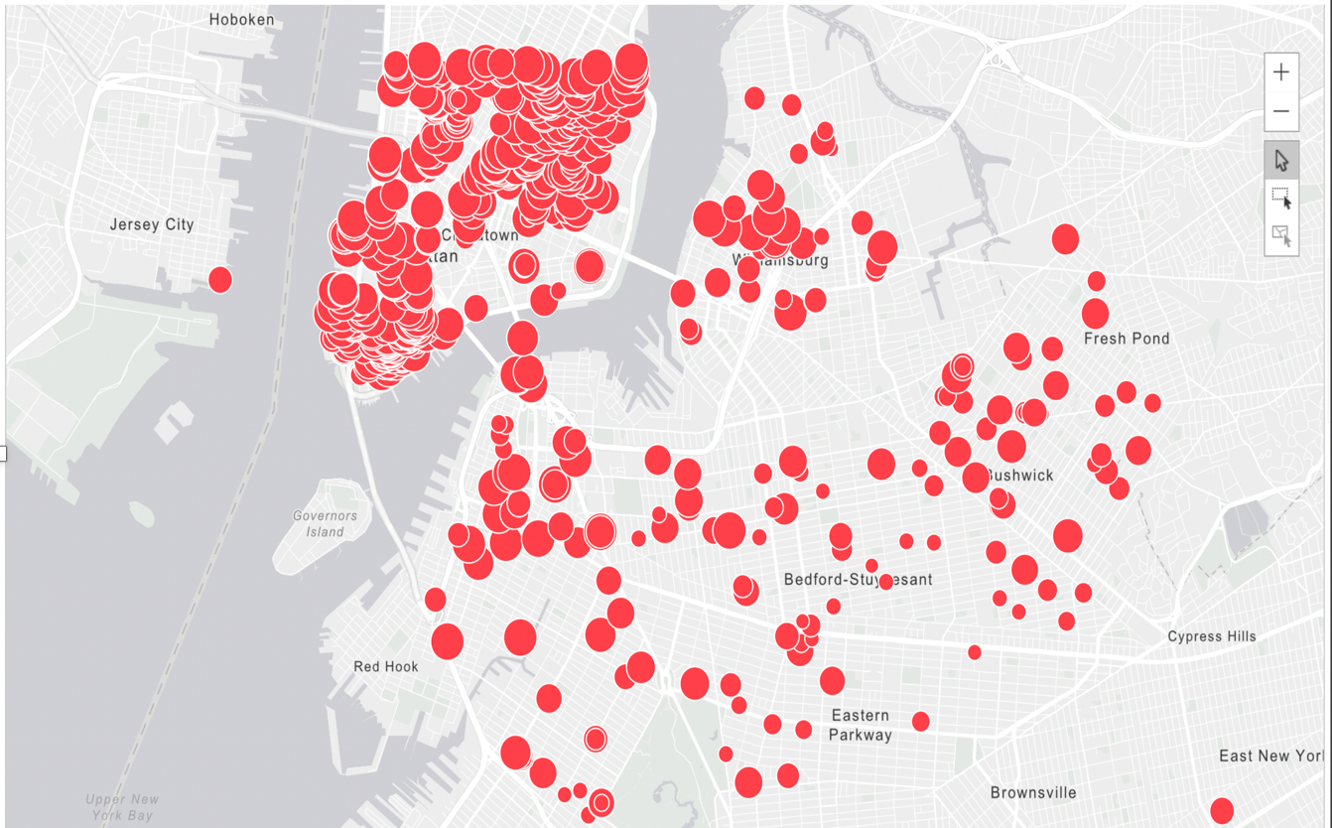
EDA: LOCATIONS OF PROPERTIES - LOW

Slide 6
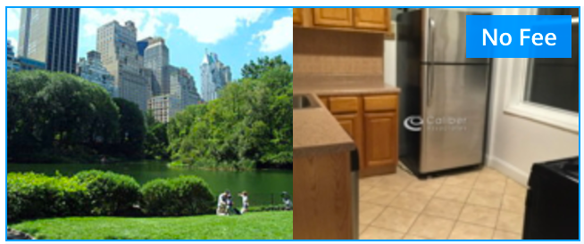
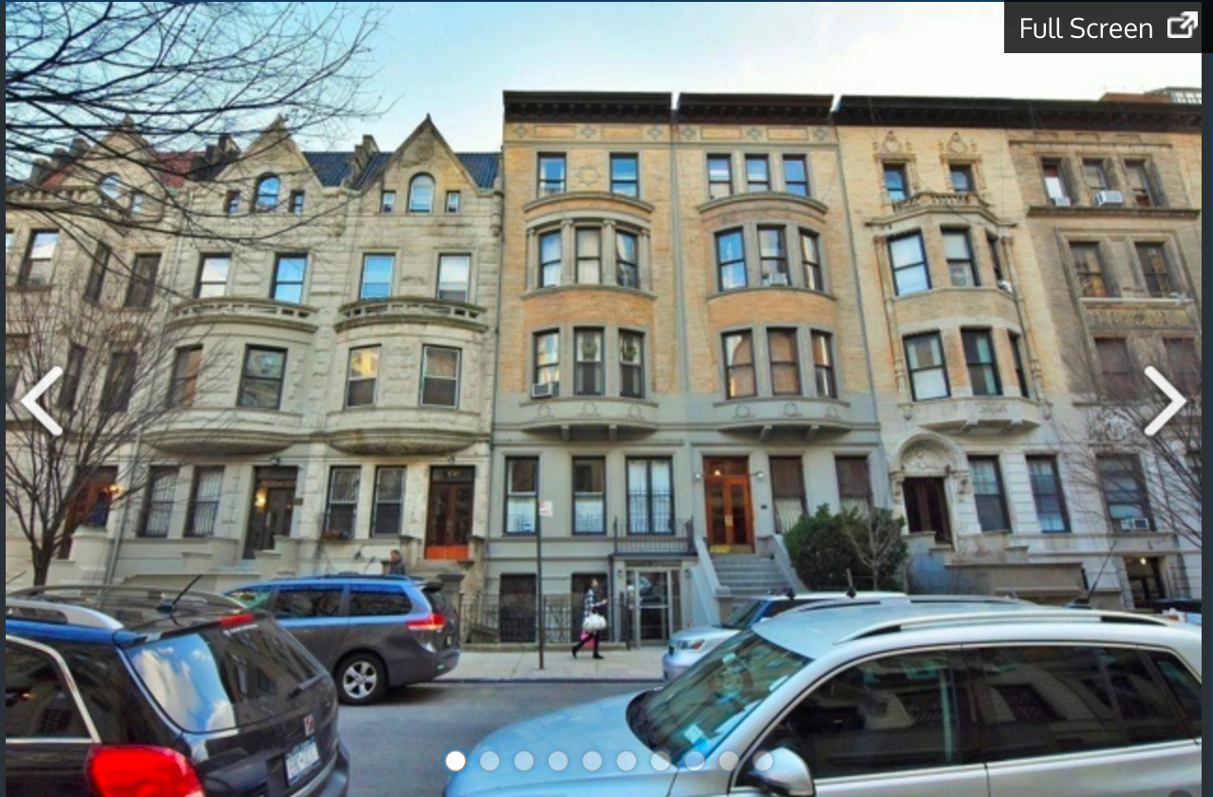
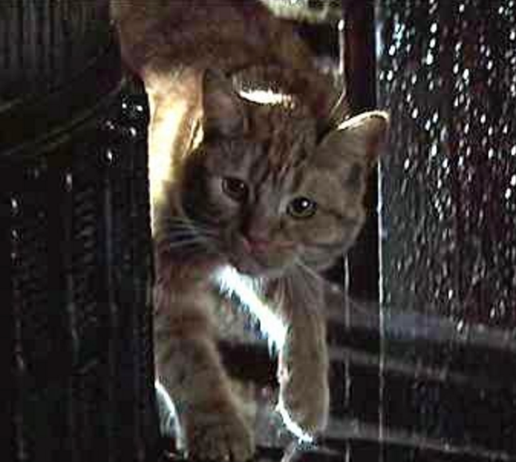
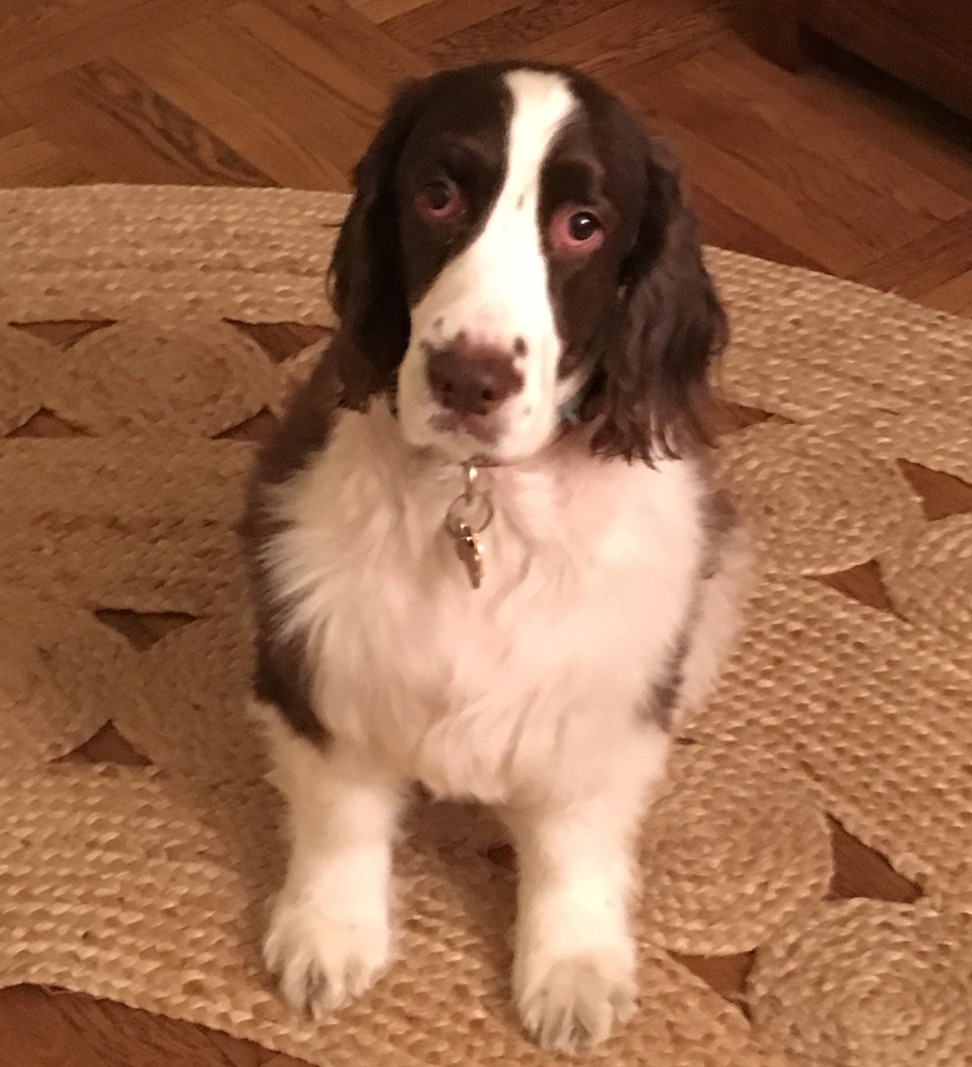
EDA: FEATURES
Features utilized in tree model providing marginal improvement in predictive score
We determined the 69 most frequent attributes and clustered them into 19 predictors
Most important features used:
Fee: No Fee or Low Fee
Prewar
Pets
Least important features:
Playroom
Proximity to subway

Slide 7
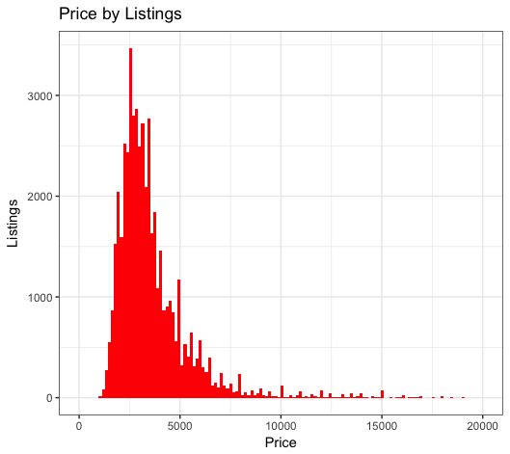
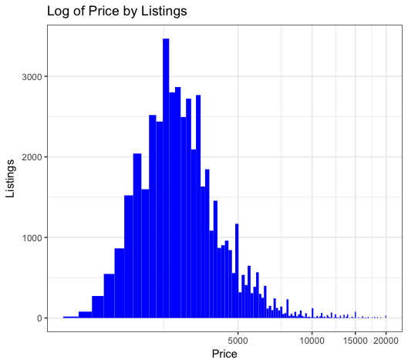
EDA: PRICE, LATITUDE & LONGITUDE
Best scoring predictors in tree model by Gini index: PRICE, LATITUDE & LONGITUE
Intuitive: most renters in NY looking within a specific price range
The old real estate adage: LOCATION, LOCATION, LOCATION

Slide 8
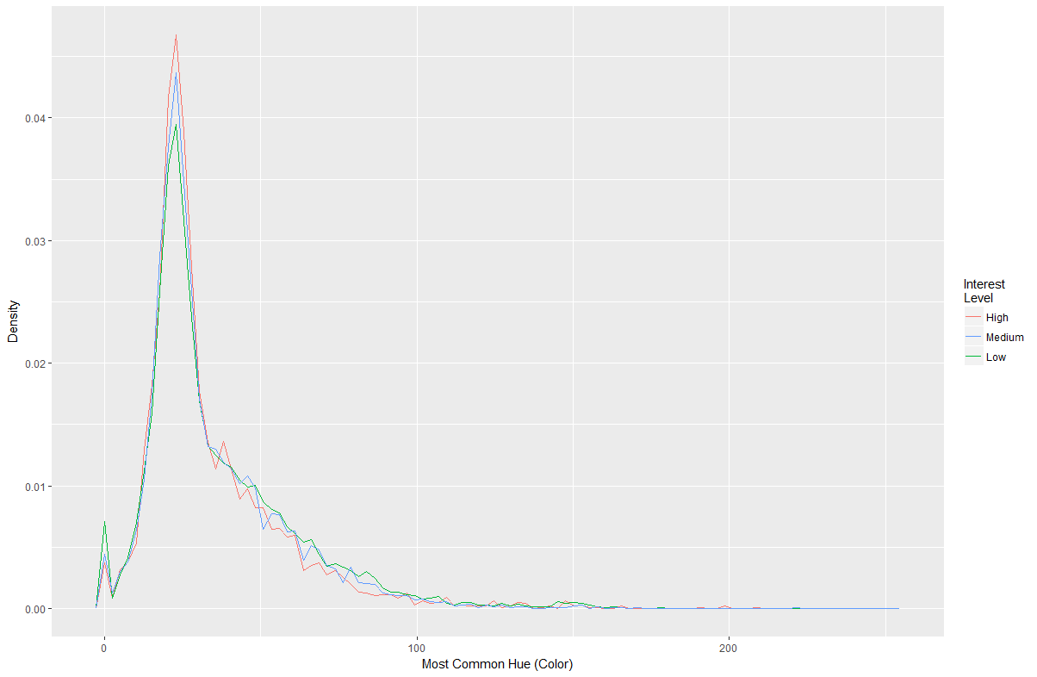
EDA: IMAGE HUE
Images do not provide enough data to be predictors in our analysis – they are too similar

Slide 9
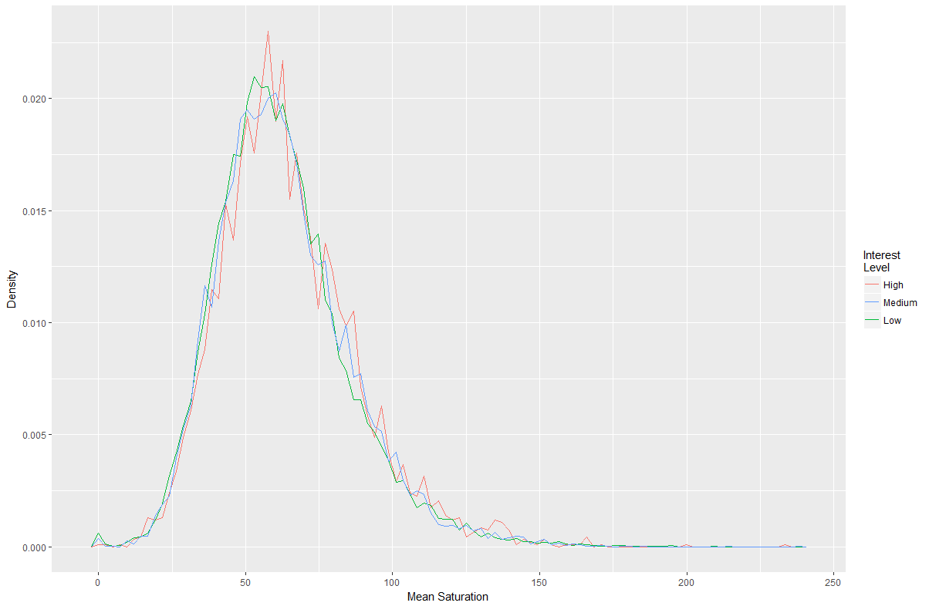
EDA: IMAGE SATURATION

Slide 10
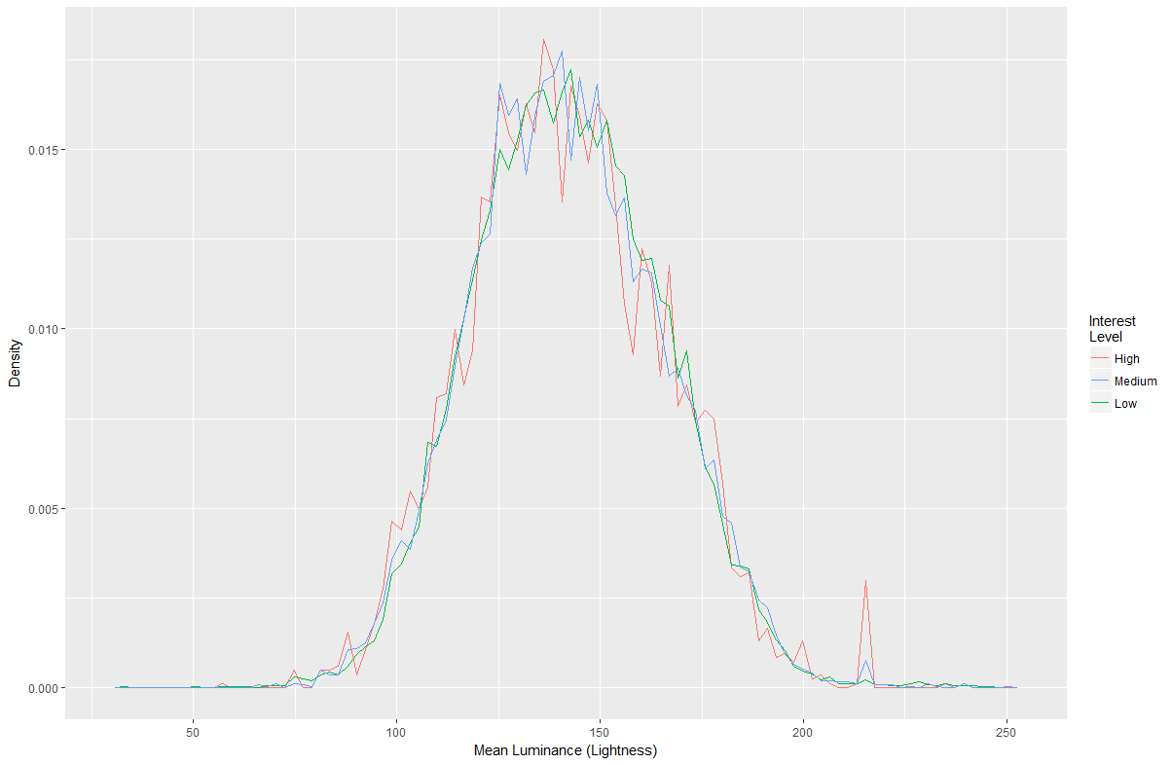
EDA: IMAGE LIGHTNESS

Slide 11
MACHINE LEARNING ALGORITHMS
Models created for ensemble model and final scoring with different predictors:
KNN
xgBoost
logistic
Tree
SVM

Slide 12
SVM MODEL OVERVIEW
Parameters:
kernel='radial‘
cost=100
Results
Model Statistics
Accuracy : 0.6998; 95% CI : (0.6923, 0.7072)
No Information Rate : 0.9672 ; P-Value [Acc > NIR] : 1
Kappa : 0.0629; Mcnemar's Test P-Value : <2e-16
(Pred/True) | Low | Medium | High
Low | 10,152 | 3,124 | 1,044
Medium | 137 | 208 | 133
High | 3 | 4 | 1

Slide 13
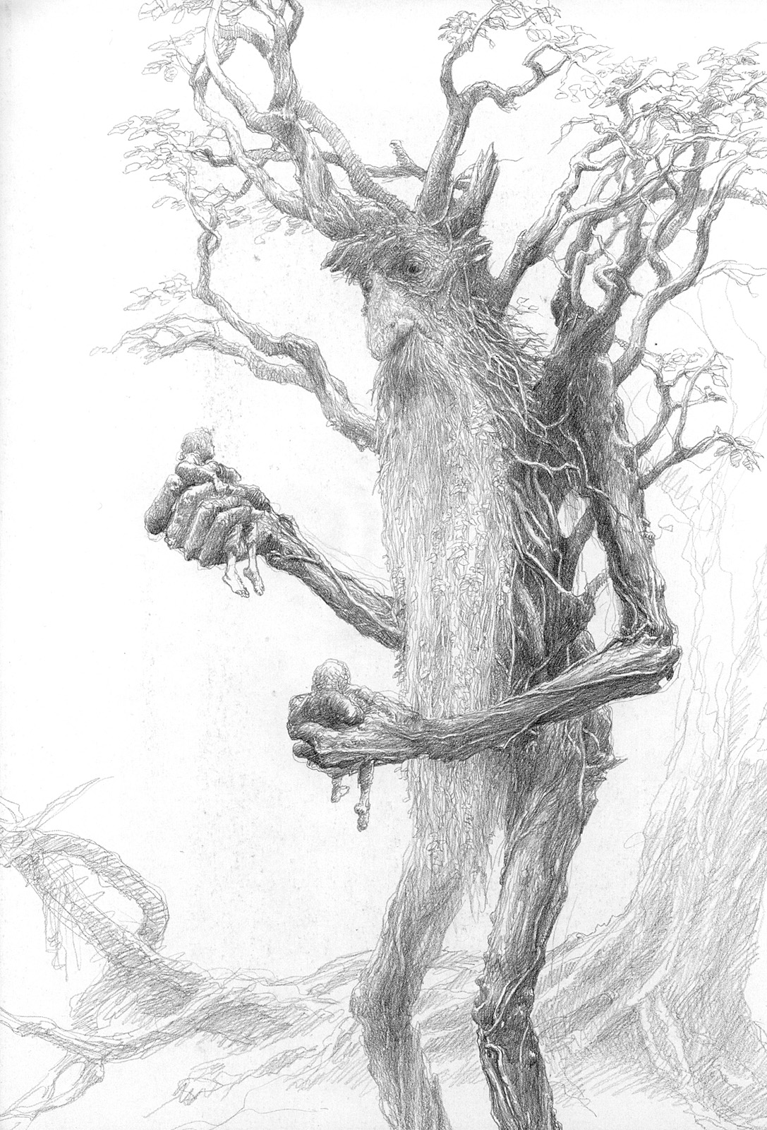
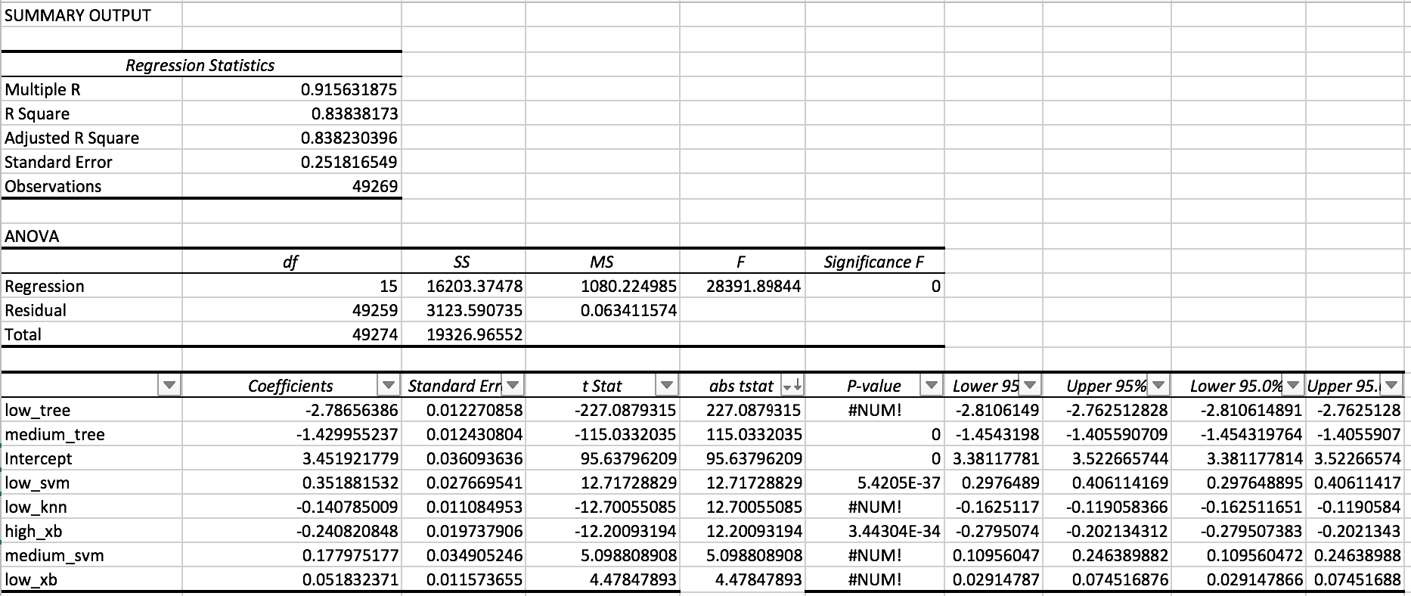
ENSEMBLE ALGORITHMs RESULTS WITH TREE

Slide 14
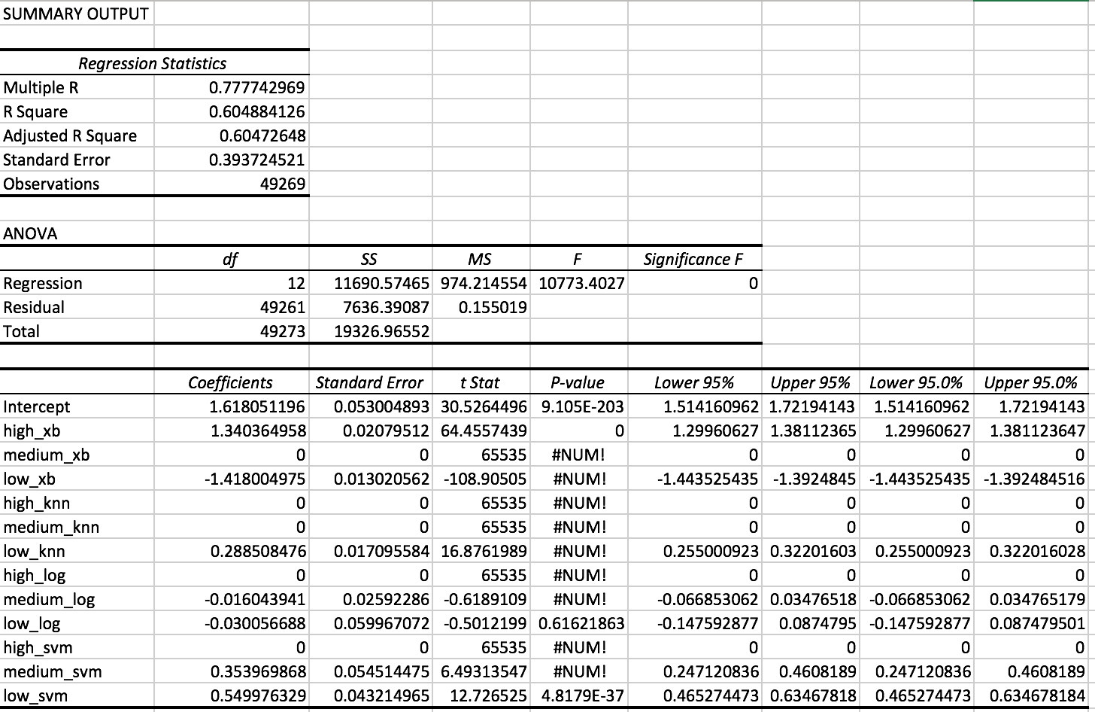
ENSEMBLE ALGORITHMS RESULTS WITH NO TREE

Slide 15
Ensemble Model Created with SVM (No Tree)
Parameters:
SVM-Type: eps-regression
SVM-Kernel: radial
cost: 1
gamma: 0.08333333
epsilon: 0.1
Training Data Accuracy:
Model Score for Test Data:
Kaggle Model Ranking:

Slide 16
NEXT STEPS & FUTURE ITERATIONS
Tree model with less over-fit
Test with a neural network
More time to fully process images
Further research features

